Slide 1
Sharing economy

Slide 2
Objectives of the topic
To determine definition of sharing economy
To understand form of sharing economy
To analyse examples of sharing economy

Slide 3
Definition
variety of different products and services that are distributed or accessed by sharing or through collaborative practices. Today, it is possible to find sharing models in practically every sector including transportation, healthcare, financial services, food, fashion, telecommunications, construction, etc ()
The sharing economy as digitized platforms for peer-to-peer exchanges has several implications for exchanges, or the accessing of resources. These include the following:
entirely new understandings about the interaction between users and producers;
the ability to connect otherwise unconnected individuals;
users appearing as both supplying and using parties;
individuals, rather than companies, being the central unit of exchange;
the transactional characteristic of exchanges as users and producers are matched via the platform, rather than producers being pre-selected by the users. (A. Geissinger et al., 2019)
Notes:
Examples range from platforms facilitating shortterm
rentals (e.g., Airbnb) and ridesharing (e.g., BlaBlaCar) to tool
Only in Europe, the
sharing economy has generated revenues of nearly e4bn and facilitated e28bn of transactions
in 2015 [47].

Slide 4
Collaborative consumption
collaborative consumption, popularized by Botsman and Rogers (2010), can be considered a rather all-encompassing approach, defining collaborative consumption as “systems that reinvent traditional market behaviors renting, lending, swapping, sharing, bartering, gifting in ways and on a scale not possible before the Internet

Slide 5
Synonyms or classification
sharing economy or shareconomy
collaborative consumption
collaborative economy
gig economy
access-based consumption
platform economy
peer-to-peer economy
on-demand economy
Microtask, microwork, micro-tasking, micro-working

Slide 6
Gig economy
The gig economy is a free market system in which temporary positions are common and organizations contract with independent workers for short-term engagements.
The term "gig" is a slang word meaning "a job for a specified period of time" and is typically used in referring to musicians.
Examples of gig employees in the workforce could include freelancers, independent contractors, project-based workers and temporary or part-time hires.

Slide 7
Summary of definitions
Concept | Definition
Access-based consumption | transactions that may be market mediated in which no transfer of ownership takes place. It is similar to sharing, that the both modes of consumption do not involve a transfer of ownership.
Collaborative Consumption | traditional sharing, bartering, lending, trading, renting, gifting and swapping, redefined through technology and peer communities. It is enabling people to realize the enormous benefits of access to products and services over ownership, and at the same time save money, space and time; make new friends; and become active citizens once again”
Sharing economy | Consumers granting each other temporary access to under-utilized physical assets (‘idle capacity’), possibly for money. Typical goods that are currently being shared are cars and homes
Collaborative Consumption | peer-to-peer-based activity of obtaining, giving, or sharing access to goods and services, coordinated through community-based online services.”
Sharing economy | activities or platforms which facilitate the sharing of material, products, product services, space, money, workforce, knowledge, or information based on for-profit or non-profit transactions in a variety of different market structures (B2C, C2C, C2B, B2B, and G2C).
Sharing economy | In the sharing economy, new ventures develop and deploy digital platforms to enable peer-to-peer sharing of goods, services and information. The underlying proposition of sharing economy firms is that they can add value by allowing owners of resources to make their idle personal assets (e.g., rooms or homes) available to those who need them (e.g., travelers).”
Sharing economy | services intended to replace ownership with the sharing and exploitation of underused assets, ranging from cars, houses, and parking spaces to pets, books, clothes

Slide 8
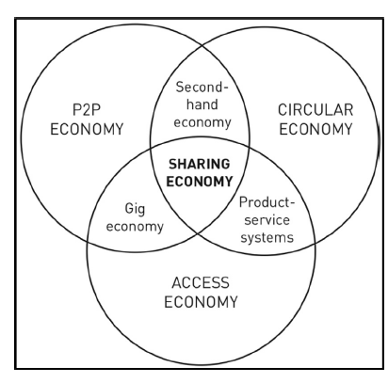
Sharing economy and its related concepts
By (Frenken, 2017).

Slide 9
Circular economy
It set of activities and practices aimed at minimizing waste, reducing resource depletion in the production of new goods, extending a product’s life through maintenance and repair, reusing existing products by sharing and remanufacturing them, and recycling products efficiently

Slide 10
Access economy
access economy refers to the shift from private ownership (e.g., purchase) to temporary access to goods and services (e.g., rental) in exchange for a payment based on membership and/or usage with the concepts of non-ownership services , product e-service systems and product-sharing services where multiple customers sequentially share the usage of a good owned by a firm.

Slide 11
P2P economy
P2P economy is based on the same network effects as the P2P file-sharing revolution with the critical difference that individuals also share offline.
People use online platforms to organize exchanges, eventually meeting each other directly.
Charging a matchmaking fee for each P2P exchange, firms take up the role of facilitators that make it easy, convenient, and trustworthy for peer providers and consumers to participate in collaborative consumption
Notes:
In P2P markets, there
must be enough peer providers to offer products and services and
enough consumers to buy them; thus, sharing economy firms must
reach a critical mass of platform users to effectively match supply
and demand

Slide 12
Performing the sharing economy: performing sharing through community
A first performance of the sharing economy is in the enactment of community. Both the technological function and the marketing language of sharing economy platforms are orientated around community.
The interest draws upon the ability of sharing economy platforms to build communities of people around (potentially) progressive causes.
For example: Crowdfunder and change.org that enable the crowdsourcing of (financial) participation in projects and campaigns
Notes:
Sharing economy platforms enable this participation by providing new ways for attachments between people to take place through space. Rather it works as a sensibility in which
being in place is necessarily to be connected such that connectivity
is belonging (i.e. if you’re not connected you cannot belong). In this
thorough entanglement of the virtual and the material (Kinsley,
2014), digital footprints equate to ‘real’ footprints. Constant connection
means that online and offline self are difficult to distinguish.
The sharing economy utilises this merger of online and
offline through connectivity to facilitate proximities between
strangers, thereby fostering participation in a community orientated
around a particular service or resource

Slide 13
Performing the sharing economy: performing sharing through access
The sharing economy is played out in the possibility of access as both a practice and an ideal. The partial nature of such access is thrown into relief through the problems with wifi
Access to wifi (or a mobile high speed internet connection) is desirable if not essential for much of the activity of the sharing economy as defined through the presence of online platforms.
A key modality of the sharing economy concerns access to common resources. This builds on the free access built into the digital commons of cyber culture.
Most prominent amongst these ‘common’ resources are space (residential, commercial), transport (cars) and labour (taxi drivers, ‘taskers’).

Slide 14
Performing the sharing economy: performing sharing through collaboration
The sharing economy operates through people working together to produce something.
Even when not in a formal collaboration, ‘co-working’, being in the same location as others (often in a similar field), can provide serendipitous co-production.
The growth of co-working spaces capitalises on these long recognised advantages of proximity for innovation
However, digital technologies mean that such co-production does not have to take place at the same time nor in the same place.
Collaboration in the sharing economy encompasses open and decentralised practices that blur (and casualise) production and consumption

Slide 15
Performing the sharing economy: performing sharing through collaboration
The ‘collaborative economy’ is often used interchangeably with the ‘sharing economy’ to point to the way the crowdsourcing of goods and services involves forms of cooperation.

Slide 16
Platforms most referenced as examples of the sharing economy
Technological platform | % of publications
Airbnb | 21.15%
Uber | 19.77%
Amazon mechanical turk | 11.72%
Taskrabbit | 5.29%
Zipcar | 4.14%
Crowdflower | 4.14%
Lyft | 3.45%
Couchsurfing | 3.22%
Car2go | 2.07%
Relayrides | 1.84%
By Will Sutherland and Mohammad Hossein Jarrahi (2018)

Slide 17
Shared mobility sector
for example, “carsharing,” “bikesharing,” and “ridesharing” were identified as different business model categories
Mobility and vehicle sharing services form the largest sector of the sharing economy and has attracted considerable attention.

Slide 18
Shared mobility sector
five types of services:
carsharing (e.g., Zipcar, car2go),
bikesharing (e.g., Citi Bike, Divvy, Capital Bikeshare),
transportation network companies (TNCs)
ride-hailing, such as Lyft, Turo, Uber),
microtransit (e.g., Bridj, Chariot),
taxi apps (e.g., Flywheel, Curb, myTaxi)

Slide 19
Business-to-consumer leasing
Fleet management firms or car dealerships offering contractual leasing services of vehicles to other firms or to private customers were the precursors of the sharing economy, providing the benefits of car ownership without its burdens
Notes:
Essentially, it is an alternative to financing
a purchase by credit. Car leasing customers acquire permanent use
of a car over a long period (from six months to several years); thus,
they perceive the car as their own property (i.e. psychological
ownership; Peck and Shu, 2018), while legal ownership remains
with the firm. Leasing services are B2C solutions based on PSS

Slide 20
Peer-to-peer car rental
Peer-to-peer car rental (or P2P carsharing) is defined as enabling car owners to rent out their private vehicles to other drivers for a limited period of time.
Platforms such as Snappcar and Drivy in Europe or Turo in the U.S. facilitate the match between car owners and non-owners and provide customer support, insurance, and supporting technology, typically in exchange for a service fee and a commission

Slide 21
Ridesharing
Ridesharing (or carpooling) is defined as a joint trip where drivers offer empty seats in their car or van to other passengers without a profit motive
Notes:
Passengers contribute to travel
expenses but do not remunerate the driver (Shaheen et al., 2016). A
successful shared ride between long-distance travelers needs coordination
regarding itineraries and the place and time of pick-up
and drop-off (Chan and Shaheen, 2012; Furuhata et al., 2013). The
coordination between drivers and passengers is facilitated by
ridesharing platforms in exchange for a service fee and/or a commission,
or for free when operated by grassroots or non-profit
organizations.

Slide 22
Renting in sharing economy
The sharing economy is principally based on short-term renting, which could range from a continuum of non-commercial (genuine community sharing) to that of market exchange value generated through short-term commercial renting.
Botsman & Rogers describe the sharing economy as collaborative consumption, which includes “traditional sharing, bartering, lending, trading, renting, gifting, and swapping, redefined through technology and peer communities.”
https://instigating.co
Notes:
The sharing economy grew significantly in the context of Great
Recession (2007–2009), as the platforms provided new means of
earnings by renting extant assets. Gig tasks provided flexible job opportunities
in place of unemployment (Marshall, 2015). The sharing
platforms have grown both in terms of service sectors and size worldwide.
In terms of services, the

Slide 23
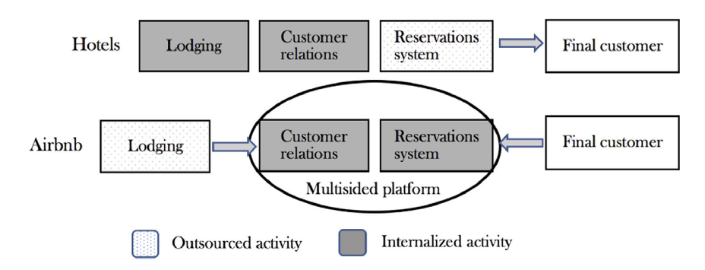
Differences between sharing economy firms and traditional businesses' organizational boundaries
By R.C. Parente et al. 2018

Slide 24
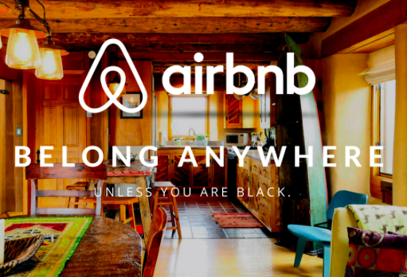
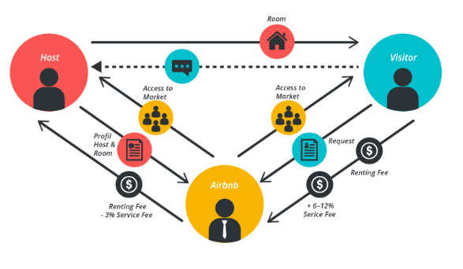
Airbnb business model

Slide 25
Labor and sharing services
The gigs are arranged through business and personal service platforms that explicitly recruit workers, or through other platforms that require such labor.
Business service platforms arrange gigs directly for businesses, such as Freelancer (with over 22 million users) and Upwork (with over 5 million users) that connect businesses with professional freelancers (e.g., web developers, mobile developers, designers, writers, accountants, virtual assistants, sales experts) across the world

Slide 26
Sharing fashion
Company | Rental services | Retail services
Rent the Runway | Consumers rent unlimited designer clothes and accessories for $99 a month or about 10% of retail price per time. | NO
Chic by Choice | Consumers can rent designer fashion for about 20% of retail price per time | NO
Armarium | Consumers can rent luxury fashion for about 20% of retail price per time | NO
Ann Taylor | A womenswear brand offers unlimited clothes rental for $95 a month | YES
Express | Customer can rent three items for $69.95 a month | YES
New York & Co | Customer can rent three items for $49 a month | YES
By Quan Yuan and Bin Shen 2019
Notes:
For example, Rent the Runway was the first fashion
rental platform launched in 2009 and until 2018, more than 9 million people are registered as members
with US $100 million in revenue
The return rate of party dresses could be 35%-75% and the biggest return
day of the year is January 2 as the party dresses were just used in the New Year Party (Recode 2017).
Thus, one interesting phenomena in the fashion industry is that consumers have been “illegally renting”
the fashion products for decades.

Slide 27
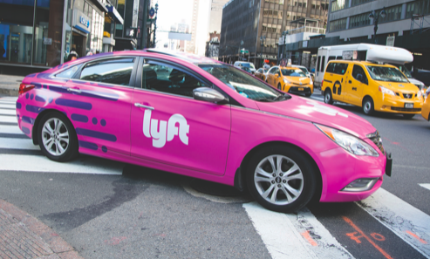
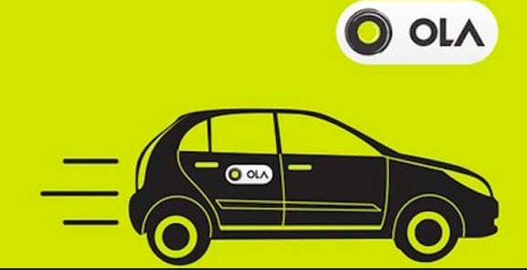
„Ubersification“
Lyft operates in more than 100 cities in the U.S.
Didi in China,
Ola in India, ,
Grab, Grabtaxi, GrabCab operate in Malaysia, Singapore, Philippines, Indonesia, Vietnam and Thailand.
Chauffeur-prive in France,
SnapCar, Gett, Gettaxi provide services in more than 50 cities in the world.
Notes:
,,Uber” įkurta 2009 metais Travio Kalanicko ir Garreto Campo. Pagrindinė būstinė San Franciske, Kalifornijoje JAV Įmonės įplaukos 2015 metais sudarė 8,2 milijardus JAV dolerių, įmonės vertė 51 milijardas JAV dolerių. Šiuo metu įmonė veikia 66 šalyse 545 miestuose. Kas mėnesį užregistruoja 50000 vairuotojų. Vidutinis kelionių skaičius vienas milijonas.
,,Uber” aplikacija - vartotojui draugiška, paslaugos paieškos, užsakymo ir apmokėjimo procesas vyksta greitai, ryšys su serveriui ir sistema – gerai, kas daro ,,Uber” išskirtine.
,,Uber” pirmoji pradėjo teikti tokio pobūdžio paslaugą, kai dar nebuvo konkurentų, susikūrė stiprią instraktūrą, užsitarnavo klientų pasitikėjimą ir susikūrė žinomą prekinį ženklą.
Taxi išsikvietimas naudojantis išmaniuoju telefonu ir aplikacija – patogus.
,,Uber” verslo modelio trūkumai
,,Uber” kaip verslo modelis, kai kuriose šalyse uždraustas. Pavyzdžiui Italijoje.
Kai kuriose šalyse ,,Uber” verslo modelis negali veikti, nes tam nėra teisinės bazės. Dažnai iškyla klausimai dėl tokios formos verslo teisėtumo.
,,Uber” dažnai dalyvauja teismuose kaip atsakovas. Profesinės sąjungos kaltina ,,Uber” veiklos neteisėtumu, ar apėjimu tam tikrų taksi vairuotojams keliamų reikalavimų. Dažniausiai ,,Uber” kaltinamas, nes taksi vairuotojai ne licensijuoti vairuoti taksi automobilį, todėl tai – nelegalu. ,,Uber” vadinamas ,,piratiniu taksi”.

Slide 28
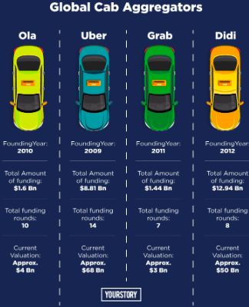
„Ubersification“

Slide 29


FinBee: Peer-to-Peer lending
With FinBee you can get a loan to buy a car, TV set, refinance your expensive credit cards or consumer loans. You can borrow if you need money for you wedding or to pay your tuition fee. We are here for you, You can always trust FinBee!
https://www.finbee.lt/en/how-it-works/instructions/
Notes:
In peer-to-peer (p2p) lending platform investors lend money to other individuals. Through this lending framework, consumer lending becomes innovative, more transparent and more profitable for both parties involved: borrowers and lenders. Lenders mitigate the individual risk by choosing which borrowers to lend to, and total risk is mitigated by diversifying investments among different borrowers.
P2P lending model was developed in the United Kingdom more than 10 years ago and today it is popular all over the world. The largest online platforms are created in the USA and UK. The latter’s government invests through the biggest national P2P lending company.
Growing popularity of p2p lending shows that investors have valued the opportunity to earn more money by taking higher risk but leaving no profit for banks or other financial institutions.

Slide 30
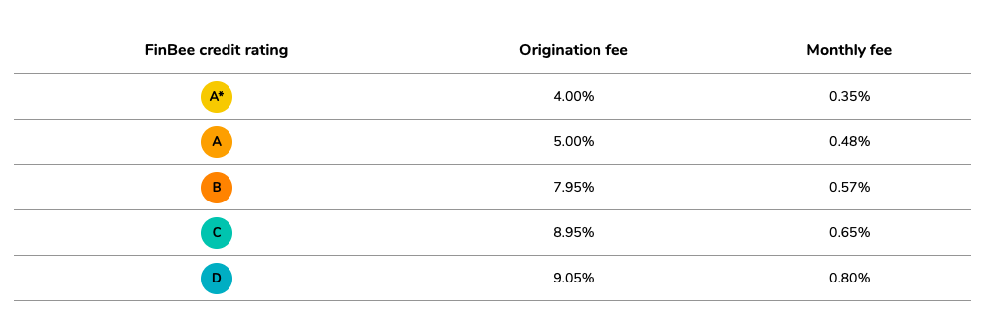
FinBee fees

Slide 31
Circular economy

Slide 32
Objectives of the topic
To define circular economy
To understand activities and business models in circular economy
To analyse several examples

Slide 33
Definition
Circular Economy is generally understood by the business world as a model that is “restorative and regenerative by design, and aims to keep products, components, and materials at their highest utility and value at all times” (Milliar et al. 2019)
Circular Economy is that it aims to identify an optimal level of loop closing to create a minimum need for extracting virgin raw materials due to the processes of minimising waste, extending product life, maintaining materials at their highest level, optimising reuse and utilizing energy sources such as biomass as a strategy to close material loops via ecosystem processes (Webster, 2015; Stahel, 2016).

Slide 34
the Circular Economy is “an economic system that represents a change of paradigm in the way that human society is interrelated with nature and aims to prevent the depletion of resources, close energy and materials loops, and facilitate sustainable development (Ormazabal et al. 2018)

Slide 35
Importance of circular economy
Circular Economy can improve social equity, promote economic growth and permanently reduce the rate of extraction of raw materials by closing material loops.

Slide 36
Origins of the Circular Economy
The origins of the Circular Economy are not attributed to a particular author, however it has been commonly suggested that the general dea emerged from the work of Boulding (1966: 5) who proposed that the Earth was a closed system with “limited assimilative capacity and as such the economy and environment must coexist in equilibrium

Slide 37
Circular Economy Schools
environmental economics (Pearce and Turner, 1990),
industrial ecosystems (Jelinski et al., 1992);
cleaner production (Stevenson and Evans, 2004);
product-service systems (Tukker, 2015);
biomimicry (Benyus, 1997);
the performance economy (Stahel, 2010);
eco-efficiency (Haas et al., 2015);
cradle to cradle design (Braungart et al., 2007);
regenerative design (Lyle, 1996)
industrial ecology (Graedel and Allenby, 2003)
closed-loop economy.

Slide 38
Sustainable Development in the Circular Economy.
An absence of Circular Economy definitions that explicitly address Sustainable Development which is allowing the concept to develop in a multitude of diverging conceptual directions that do not contemplate Sustainable Development.
A lack of coherence as to the scientific ability of the Circular Economy to achieve Sustainable Development.
Contestation as to whether the Circular Economy can achieve economic growth without degrading the environment, thus suggesting a lack of differentiation from the linear economy.
Unclear understanding as to how the Circular Economy can promote social equity or as to how the social benefits it produces can be measured.
A scarcity of reviews that make clear how the Circular Economy can be implemented whilst representing the perspectives of all those affected.
In its current form, the Circular Economy is a tool that might be more environmentally sustainable than the linear economy but could ultimately produce the similar consequences of environmental degradation, albeit at a slower temporal rate.

Slide 39
Factors associated with the companies’ perception of the Circular Advantage.
Material Provision,
Resources’ Reutilization
Financial Advantage.

Slide 40
Transition to a circular economy
the transition to a circular economy entails four fundamental building blocks
materials and product design
new business models
global reverse networks
enabling conditions

Slide 41
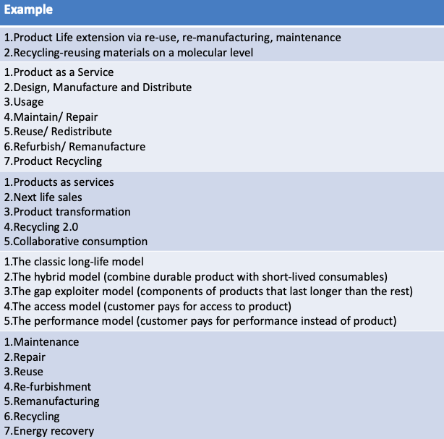
Business model categories in a circular economy

Slide 42
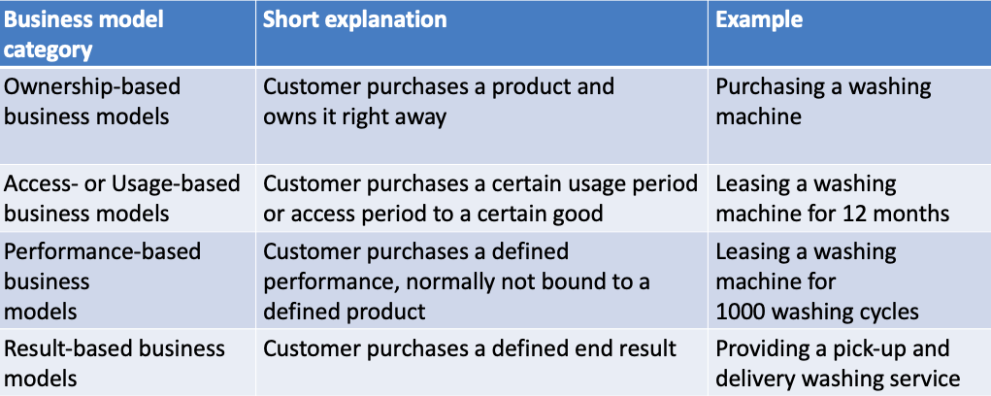
Structuring new business models in circular economy from the customer perspective

Slide 43
Structuring new business models along the circular flows

Slide 44
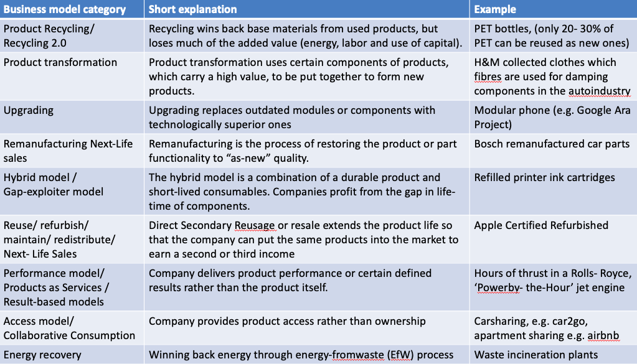

Slide 45
Textile waste
standard textile recycling lines are suitable for:
Used clothing
Tailoring clippings
Post production hard waste
Hard non woven waste
https://www.youtube.com/watch?v=i9tgis7_FSw

Slide 46
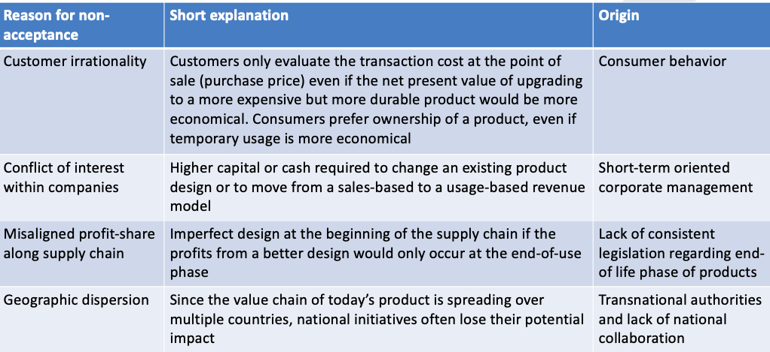
Reasons for “non-acceptance” of circular business models

Slide 47
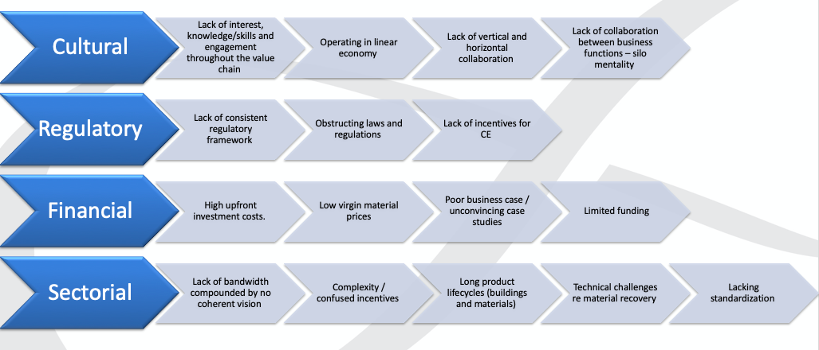
Barriers for circular economy

Slide 48
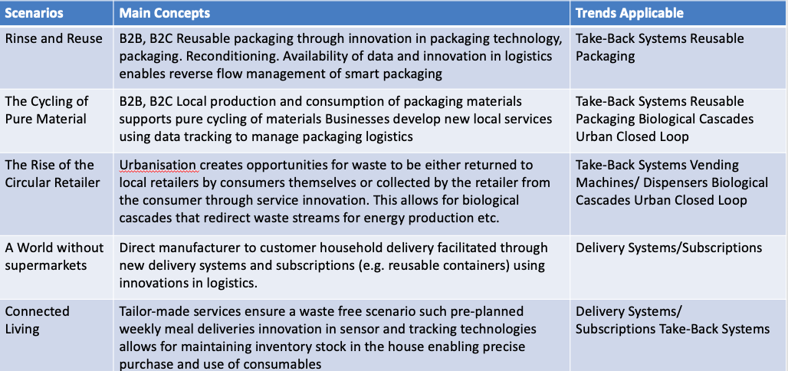
Future scenarios for fast-moving consumer goods in a circular economy (by K. Kuzmina et al. 2019)

Slide 49
Thank you

